Slide 1
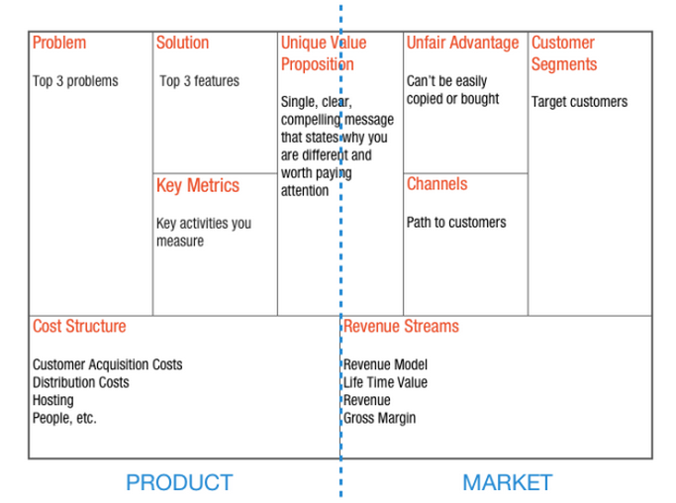
Business Model – Lean Canvas by Ash Maurya

Slide 2
Business Model versus Business Plan
Business Model
Business Plan
A single diagram of your business
A document investors make you write that they don’t read

Slide 3
Lean Canvas
The goal for today is to create a snapshot of your business model as it exists in your head
It’s okay to guess
It’s okay if you don’t have all the answers
It’s okay to leave sections blank

Slide 4
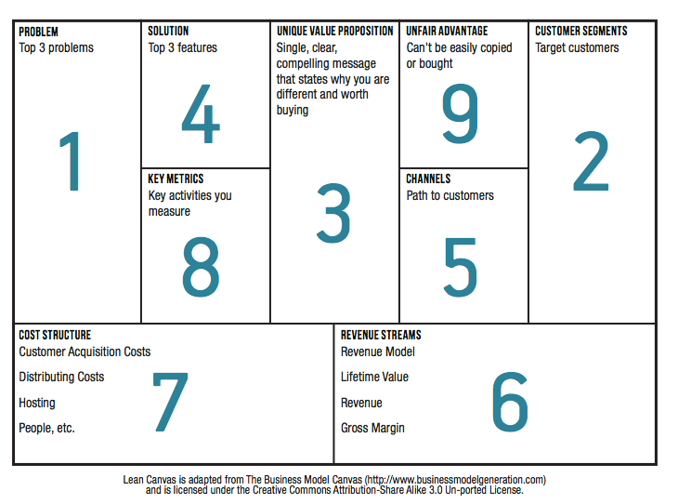
The prescribed order

Slide 5
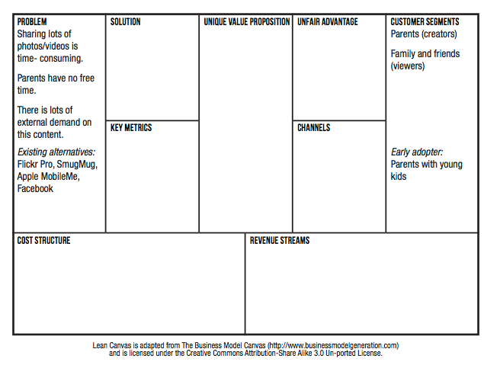
Problem and Customer Segments

Slide 6
Unique Value Proposition
Unique Value Proposition
Why you are different and worth buying/getting attention
Some Tips on how to craft a UVP
Be different, but make sure your difference matters
Target early adopters
Focus on finished story benefits
Example resume building service
A feature - “professionally designed templates”
Benefit – “eye catching resume that stands out”
Finished story benefit – “landing your dream job”
Pick your words carefully and own them
Performance – BMW
Design – Audi
Prestige – Mercedes
Picking a few key words that you consistently use also drives your search engine optimization (SEO) ranking
Answer what, who and why
Study other good UVP’s

Slide 7
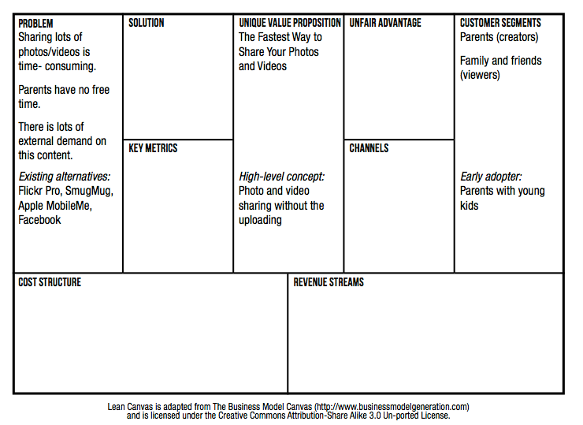
Unique Value Proposition

Slide 8
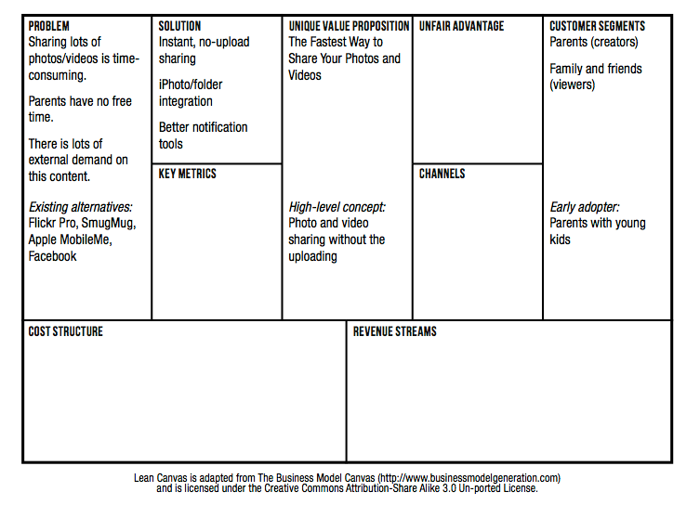
Solution

Slide 9
Channels
Freer versus Paid
Inbound versus outbound
Examples inbound channels
Blogs
SEO
Ebooks
White papers
Examples of outbound channels
Print/TV ads
Trade shows
Cold calling
Direct versus automated
Direct versus indirect
Retention before referral

Slide 10
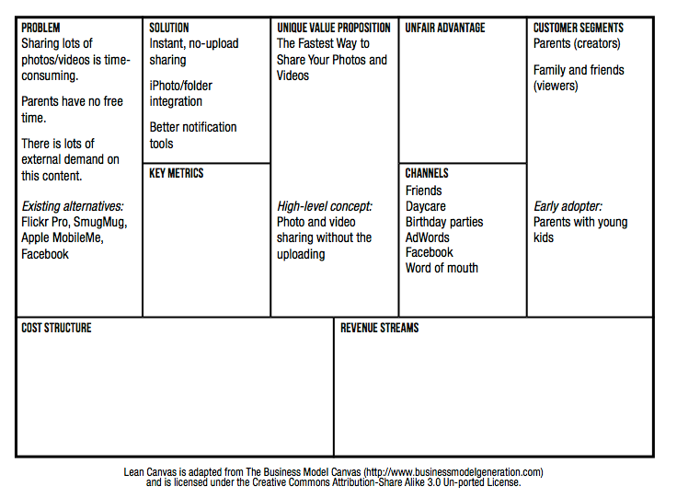
Channels

Slide 11
Revenue Streams and Cost Structure
Revenue Streams
If you intend to charge for your product you should charge from day one.
Price is part of the product
Price defines your customers
Getting paid is the first form of validation
Cost structure
It’s hard to calculate into the future. Instead, focus on the present
What will it cost you to interview 30 – 50 customers?
What will it cost you to build and launch your MVP?
What will your ongoing burn rate look like in terms of both fixed and variable costs?

Slide 12
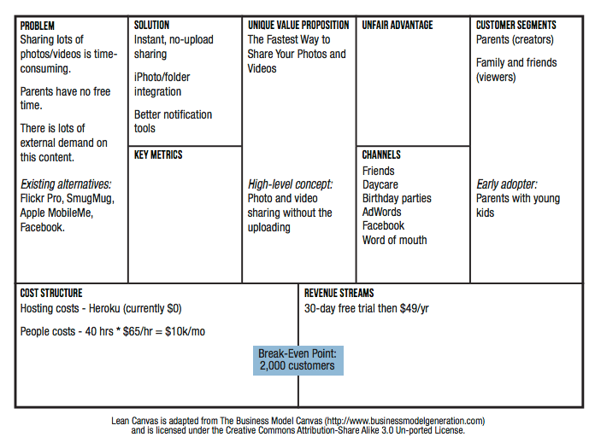
Revenue Streams and Cost Structure

Slide 13
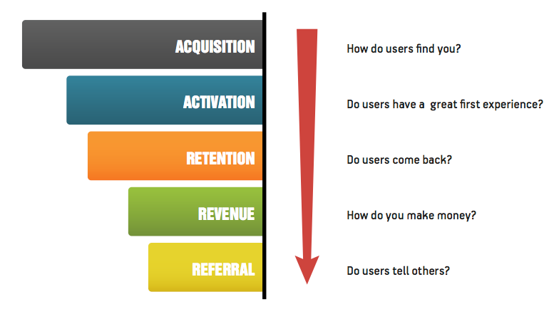
Key Metrics
Find the key number that tells you how your business is doing in real time, before you get the sales report
Source Dave McClure’s Pirate Metrics

Slide 14
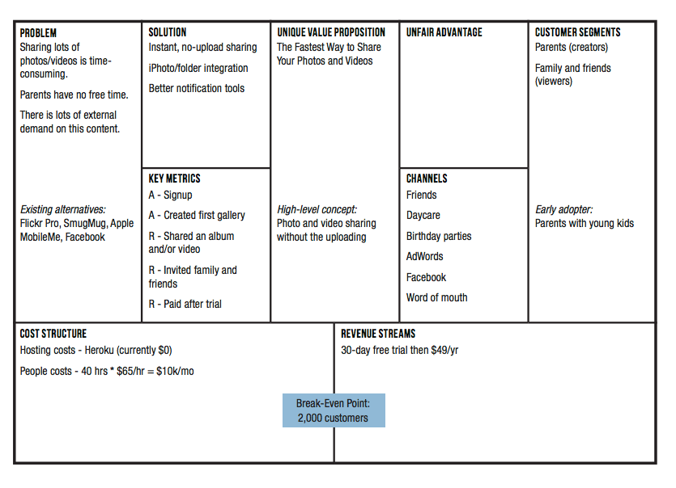
Key Metrics

Slide 15
Unfair Advantage
A real unfair advantage is something that cannot be easily copied or bought
How can/will you make yourself different and make your difference matter
Some examples
Insider information
The right “expert” endorsements
A dream team
Personal authority
Large network effects
Community
Existing customers
SEO ranking

Slide 16
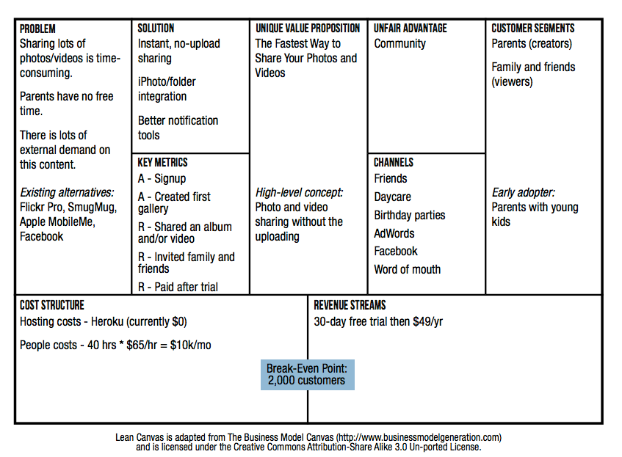
Unfair Advantage

